Slide 1

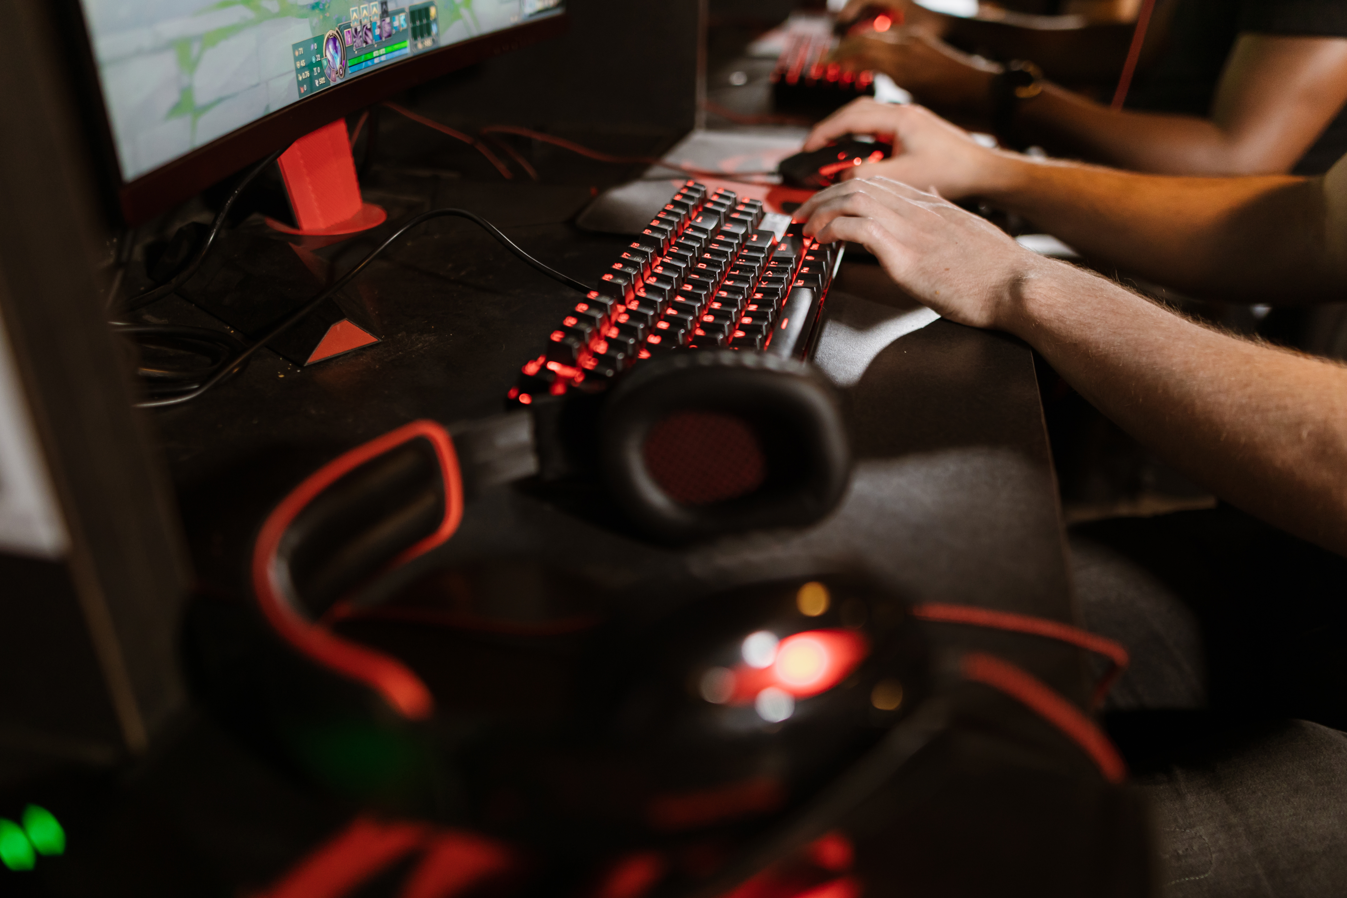



ESPORT GAME
ESPORT
GAME
LAI JUN CHENG 2370293-DCS
WONG WENG HONG 2390009-DCS
KUAN XIAN HAO 2390043-DCS
CHONG YONG SHENG 2390061-DCS

Slide 2

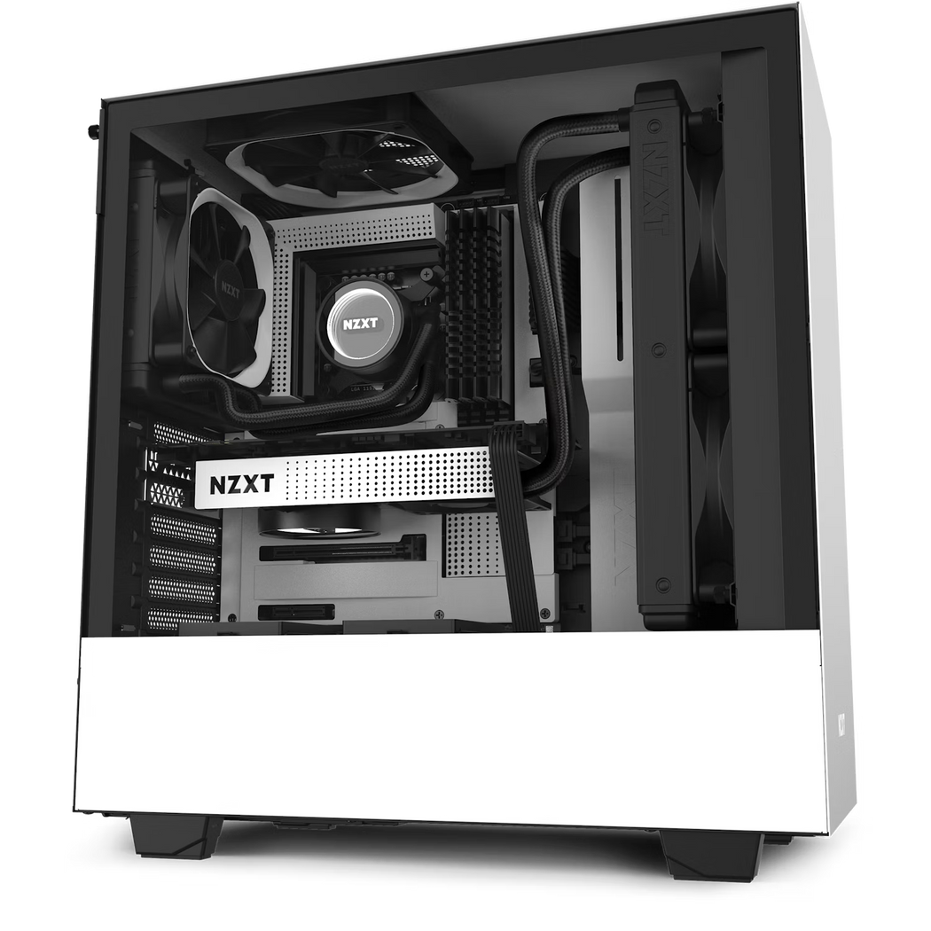
ESPORT GAME
GAME DEVELOPMENT
RM 5,000

Slide 3
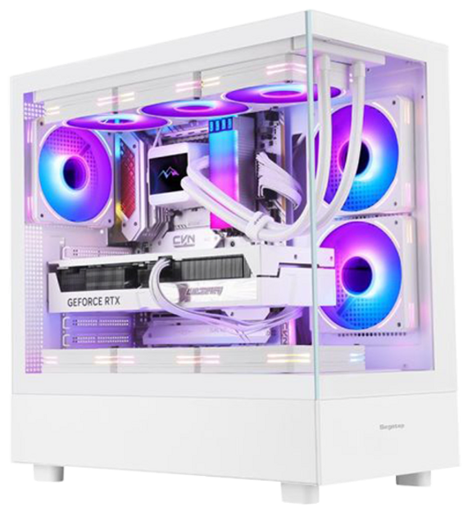
ESPORT GAME
1st PC
PACKAGE
RM 5,000

Slide 4
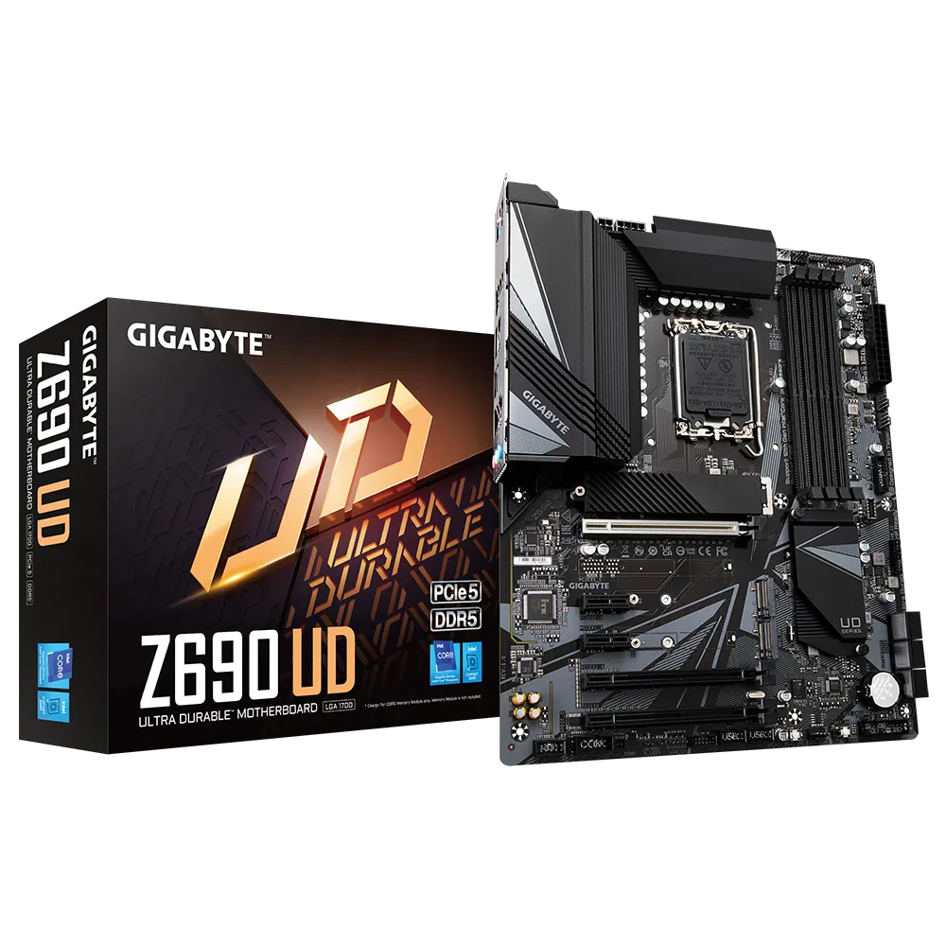
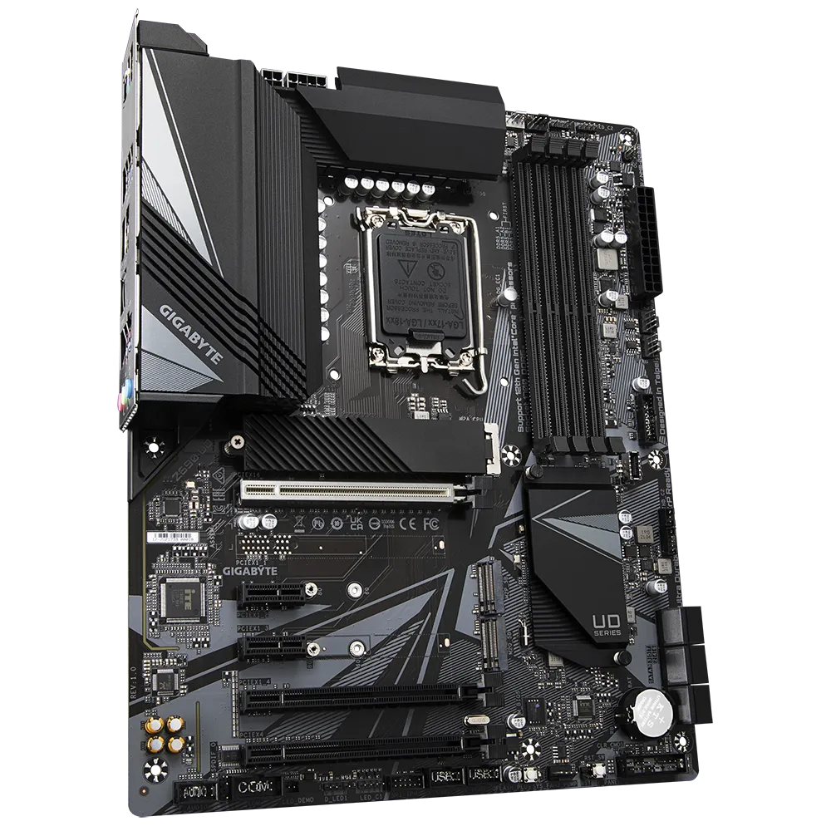
MOTHERBOARD
GIGABYTES
Z690 UD
SUPPORT OVERCLOCKING
Compatible with 12th/13th/ 14th gen intel core processors
1 x PCIe 5.0 x 16 slot
3 x PCIe 4.0 M.2 slots
DDIM slot x 4 (dual channel)(DDR5)
6 x SATA 6gb/s connectors
RMRM779

Slide 5
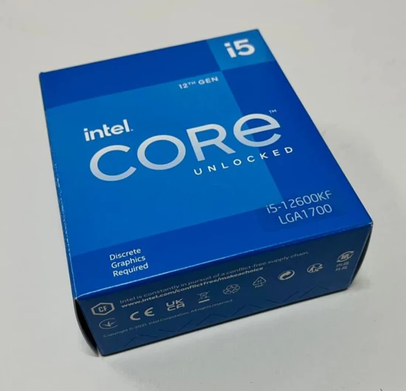
CPU
INTEL
I5-12600KF
•Support overclocking
•No integrated graphic
•10 cores(6 performances cores, 4 efficient cores)
•16 threads
•Base clock 3.70 GHz
•Max turbo boost 4.90 GHz
•Base power 125W, 150W for turbo
RM 1050

Slide 6
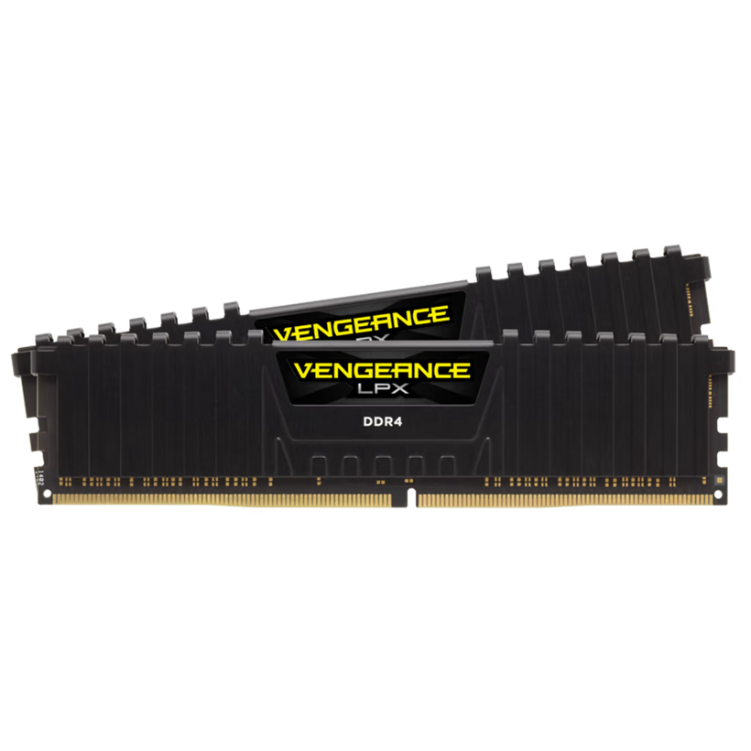

CORSAIR VENGEANCE
RAM
LPX GAMING
RAM16GB DDR4
3200MHZ (X2)
RM365

Slide 7
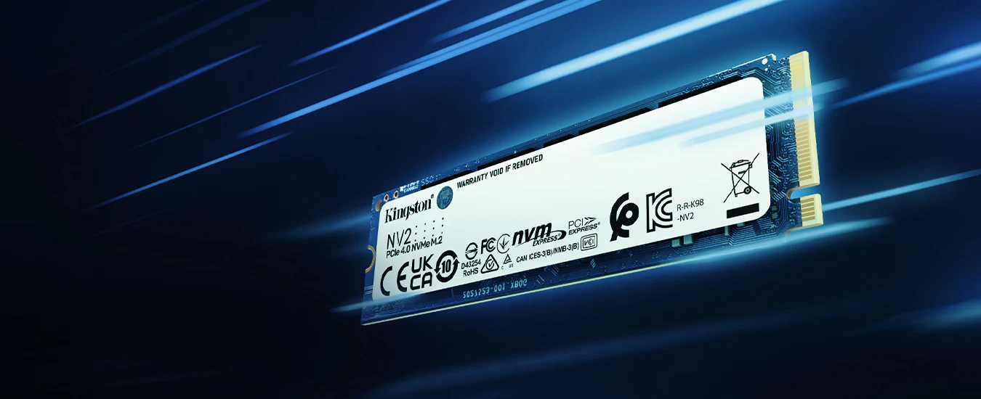
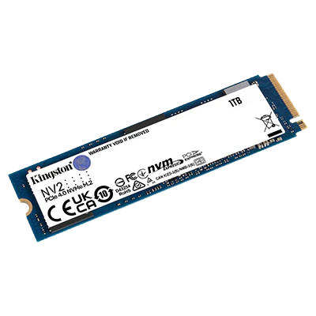
SSD
KINGSTON
NV2 1 TB SSD
1TB x 2 = 2TB
Plugged in PCIe 4.0 x 4
Read and write speed = 3500MB(s)
RM285 x 2 = RM570

Slide 8
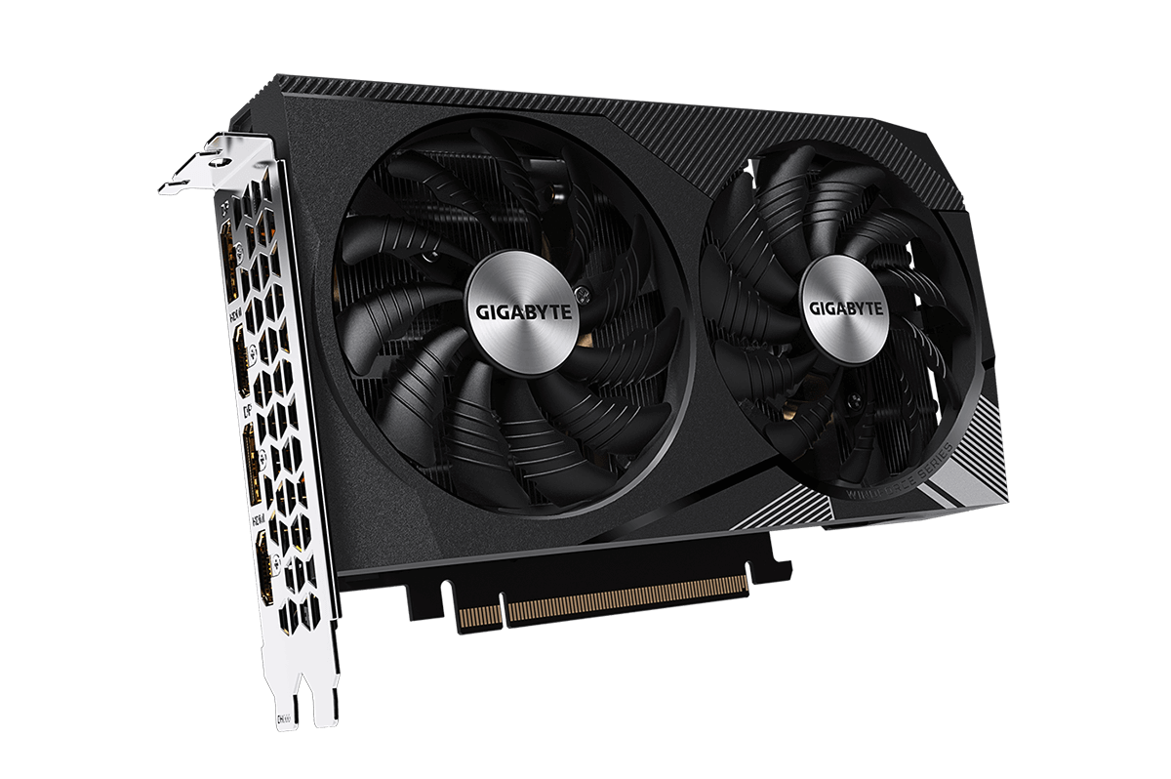
GPU
GIGABYTE
RTX 3060
WINDFORCE
OC 12GB
GDDR6
FEATURES:
Plugged in PCIe 5.0 x 16
Core clock(s):1792 MHZ
Memory clock(s): 15000MHz
Memory size: 12GB
Recommended power supply unit(PSU): 550W
RM1429

Slide 9

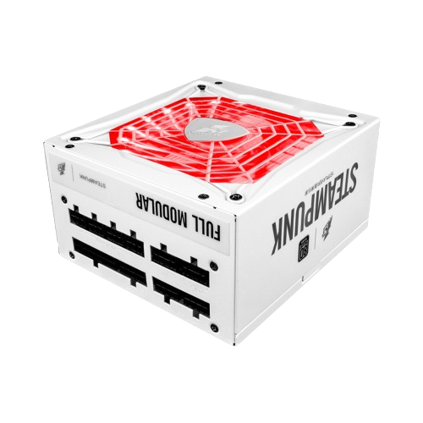
POWER SUPPLY
1ST PLAYER
STEAMPUNK
PS-750AX
FEATURES
750 W output
RM299

Slide 10
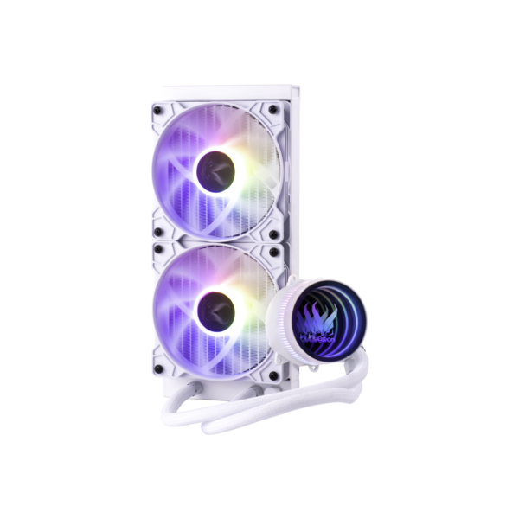
COOLING
INVASION COOLER
FEATURES
Pure copper CPU cooling block
RGB lighting effect
DX-240-ARGB 240MM AIO
RM 190

Slide 11
CASE
SEGOTEP ENDURA PRO+
TRANSPARENT PANORAMA ATX CASE COME WITH 3*120MM ARGB FAN
FEATURES
3 x 120mm ARGB fan
Suitable for:
Mini-ITX
Micro-ATX
ATX
E-ATX
RM 347

Slide 12
PRICE LIST OF 1st PC
Hardware | Product Name | Price (RM)
CPU | Intel Core i5-12600KF Processor | 1050.00
GPU | Gigabyte GeForce RTX 3060 WINDFORCE OC 12GB GDDR6 | 1489.00
Motherboard | GIGABYTE Z690 UD DDR4 | 779.00
RAM | Corsair Vengeance LPX Gaming RAM 16GB DDR4 3200MHZ (x2) | 365.00
SSD | Kingston NV2 1 TB SSD (x2) | 570.00
CPU Cooler | Invasion Cooler DX-240-ARGB 240MM AIO | 190.00
Power Supply | 1st Player Steampunk PS-750AX | 299.00
PC Case | SEGOTEP ENDURA PRO+ TRANSPARENT PANORAMA ATX CASE COME WITH 3*120mm ARGB FAN | 219.00
 | Total: | 4961.00

Slide 13
ESPORT GAME
2nd PC
PACKAGE
RM 5,000

Slide 14
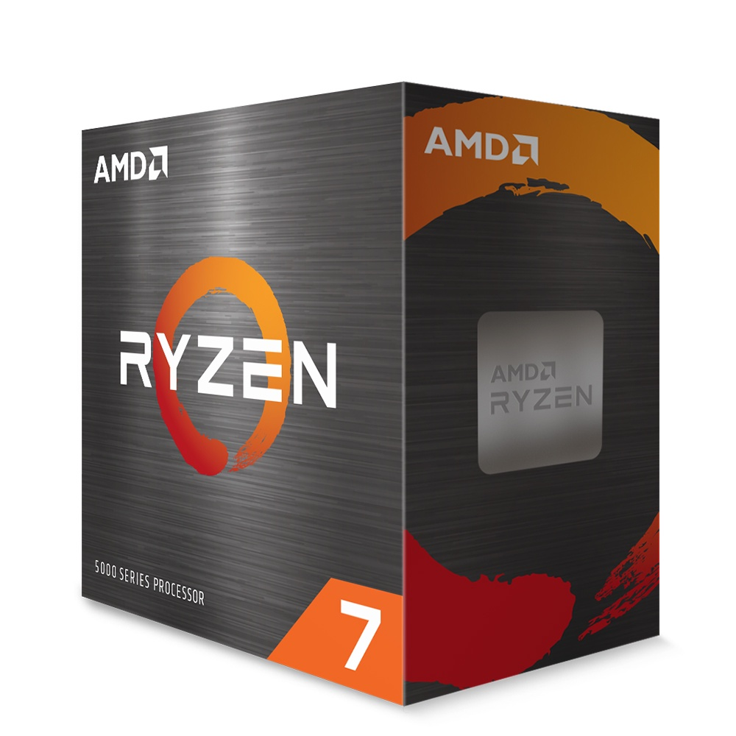
CPU
AMD
RYZEN
7 5700X 4.6GHZ
(4.5GHz, 5.4GHz Boost, 8Cores, 16Threads, 40MB Cache)
RM 748

Slide 15
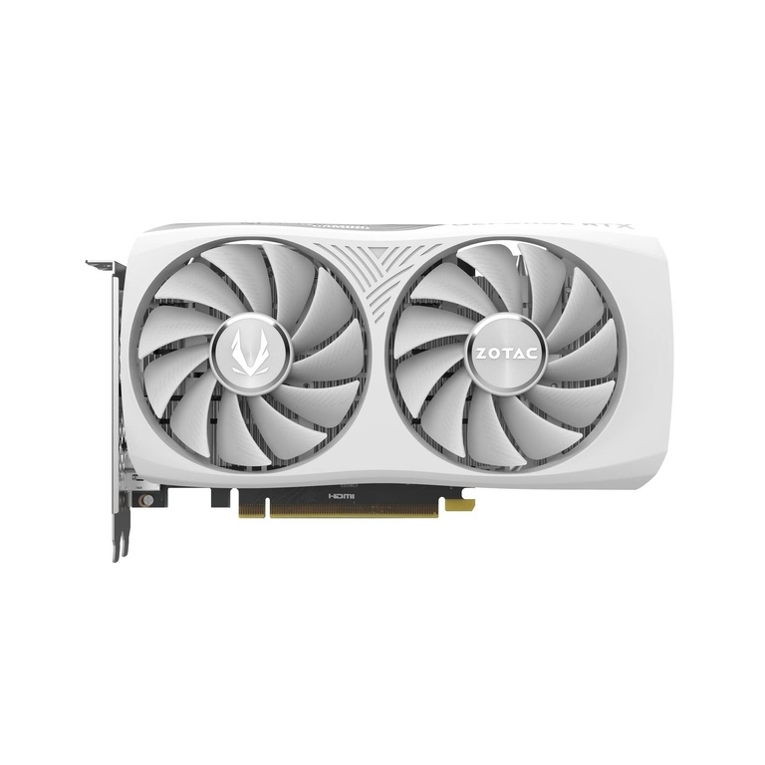
GPU
ZOTAC
RTX 4060 8GB TWIN EDGE
FEATURES
Powered by GeForce RTX 4060
Ultra-compact design with 2 Slot footprint
Memory capacity: 8GB GDDR6
RM 1,559

Slide 16
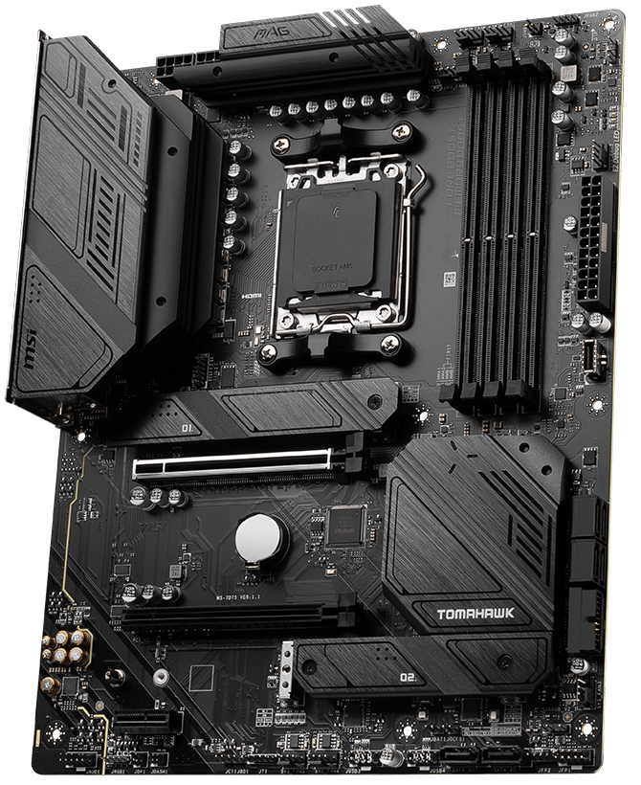
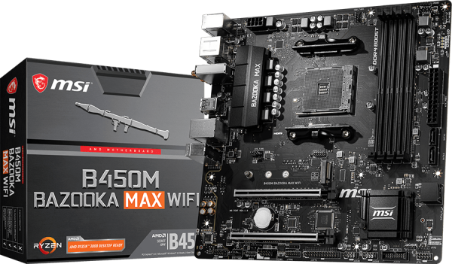
MOTHERBOARD
MSI
B450M
BAZOOKA MAX
WIFI
SUPPORTS FOR SOCKET AM4
Supports DDR4 Memory, up to 4133(OC) MHz
DDR4 Boost: Advanced technology to deliver pure data signals for the best gaming performance and stability
RM329

Slide 17
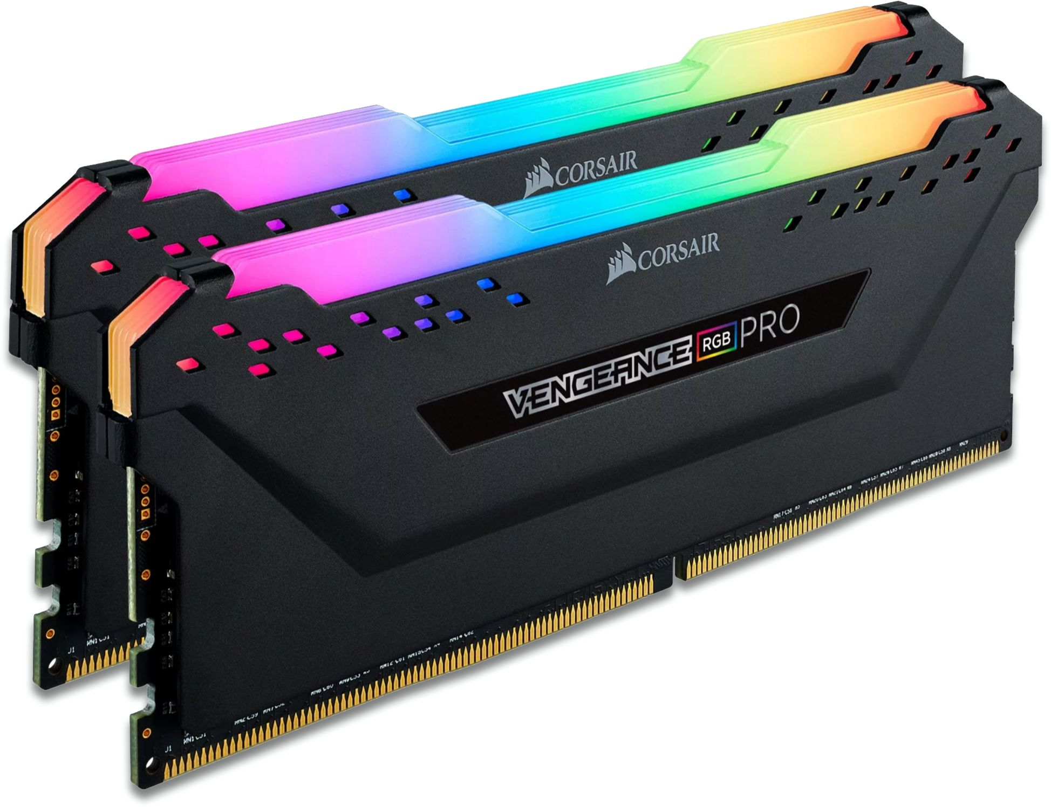
CORSAIR VENGEANCE
RAM
RGB PRO 16GB (2 x 8GB) DDR4 DRAM 3200MHz
Memory: 16GB (8×2)
Speed: 3200MHz
Type: DDR4
RM 300

Slide 18
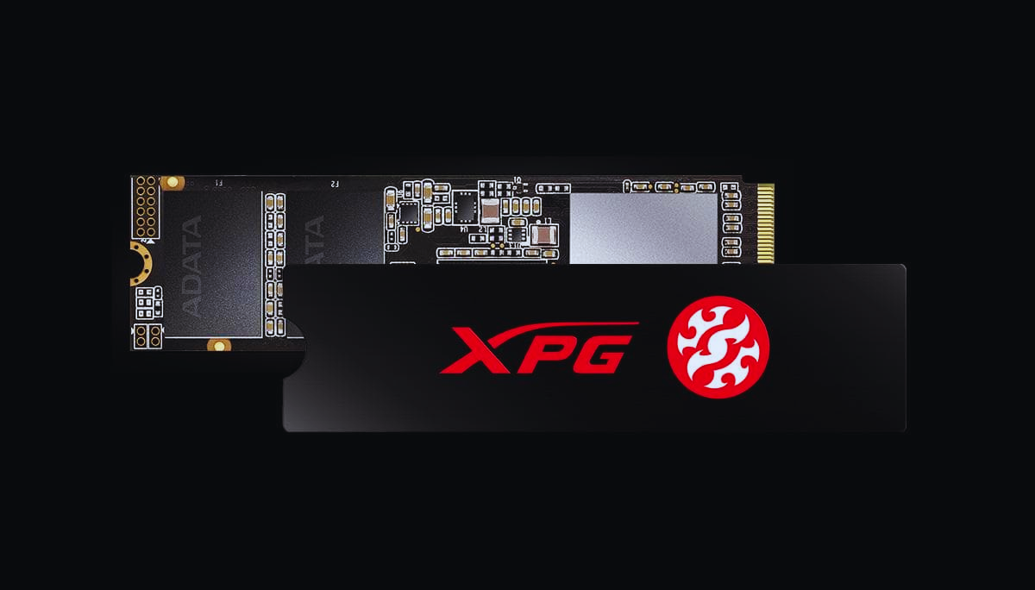
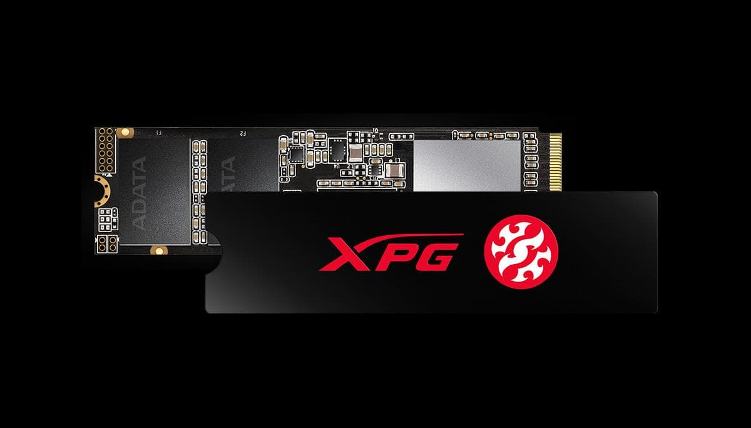
SSD
XPG
SX8200 PRO 500GB
PCIe Gen3x4
Capacity: 256GB
Form Factor: M.2 2280
Read Speed: 3500MB/s
Write Speed: 3000MB/s
RM 239

Slide 19
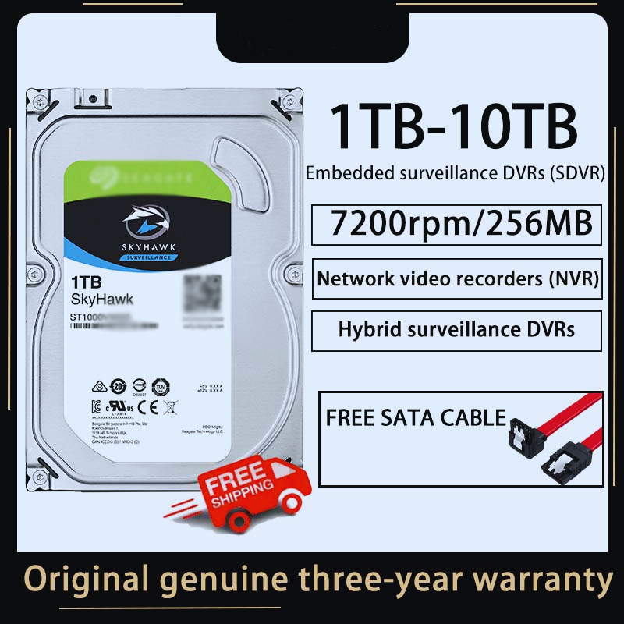
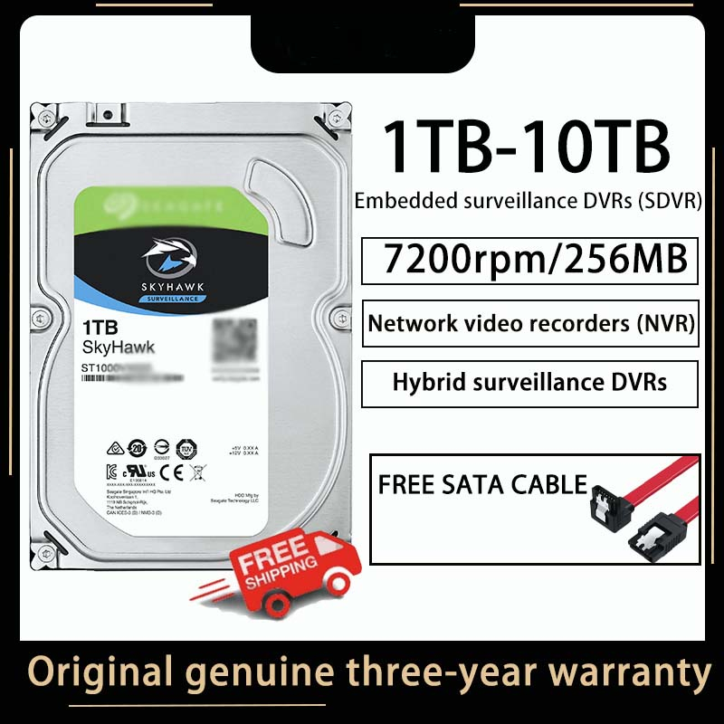
HDD
SEAGATE
SKYHAWK HDD 1TB
Rotation Speed: 7200rpm
Memory Type: DDR
Storage Capacity: 1TB
RM 130

Slide 20
Capacity: The 1TB HDD provides additional storage for assets, backups, and project files, ensuring that space constraints are minimized.
STORAGE
SEAGATE
SKYHAWK HDD 1TB
Speed: The 500GB SSD ensures fast boot times, quick loading of large projects, and smooth performance when working with large files.
XPG
SX8200 PRO 500GB

Slide 21
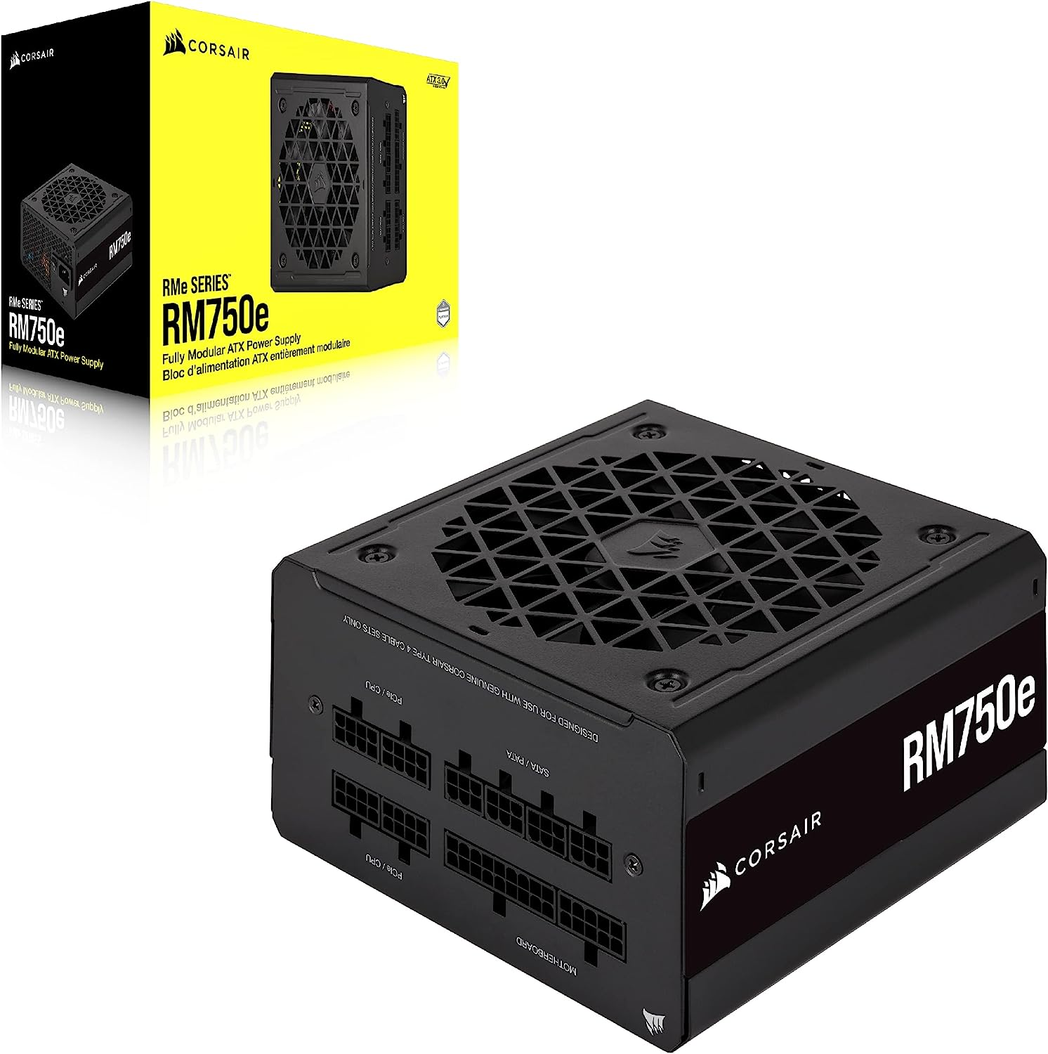
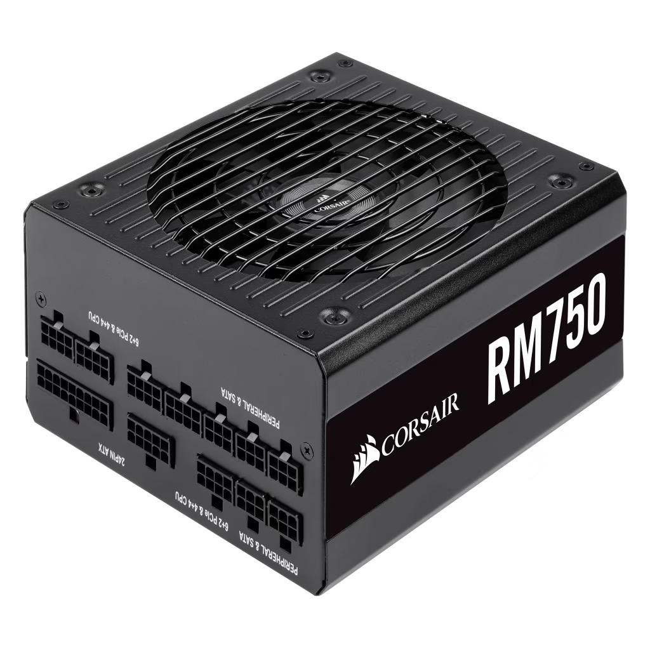
GPU
CORSAIR
RM750
750 Watt 80 PLUS® Gold Certified Fully Modular PSU
RM 440

Slide 22
CASE
NZXT H510
ATX MID TOWER CASING
FEATURES
Iconic cable management bar and uninterrupted tempered-glass side panel
USB 3.2 Gen2-compatible USB-C connector on the front panel
Cable routing kit with pre-installed channels and straps
Two Aer F120mm fans and removable filter on PSU intake
Removable bracket designed for radiators up to 280mm
RM 347

Slide 23
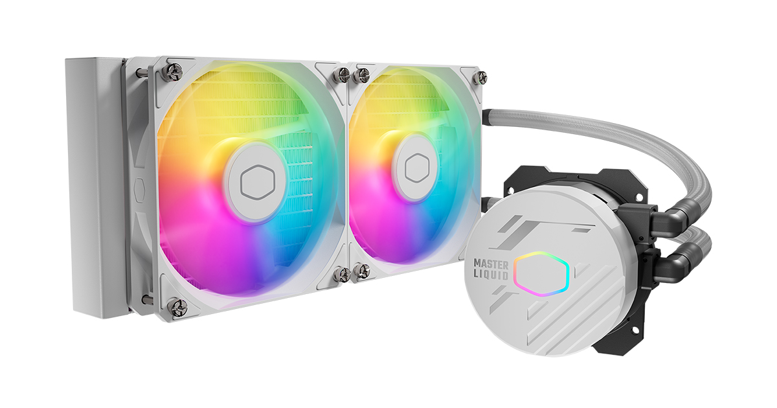
COOLING
COOLER
MASTER
FEATURES
Dual Chamber Pump
Enlarged Radiator Surface Area
Sleeved FEP Tubing
Dual ARGB Fans
CryoFuze Thermal Grease
MASTERLIQUID 240L CORE
ARGB
RM 229

Slide 24
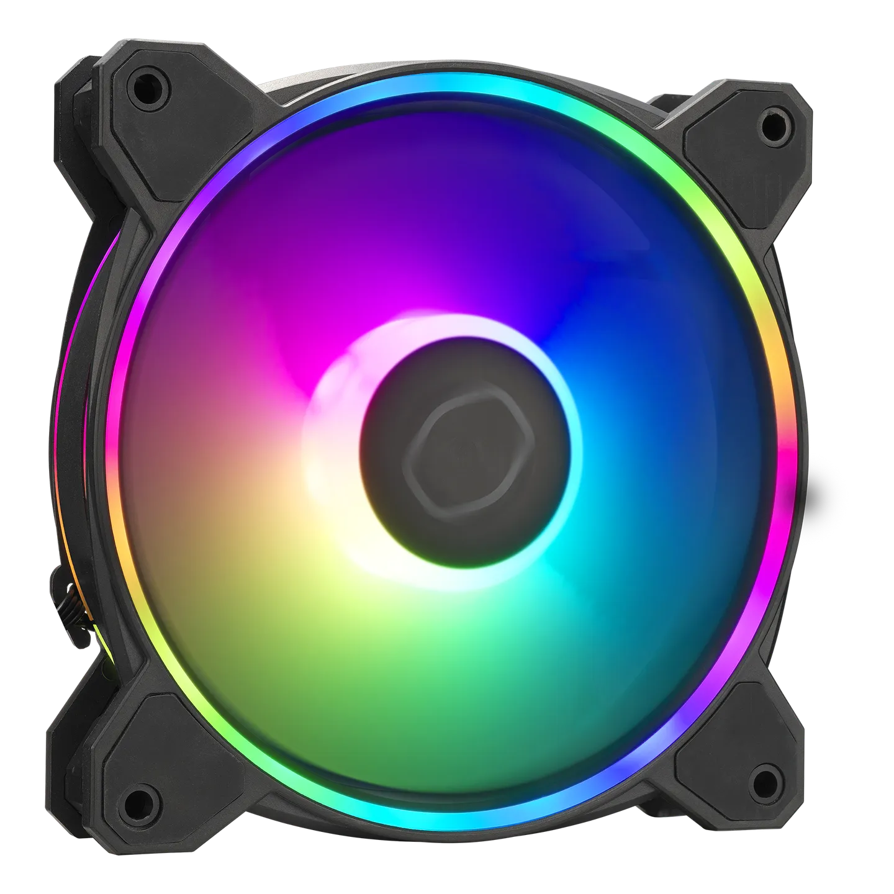

COOLING
FEATURES
UPGRADED DRIVER IC
An upgraded driver IC boosts cooling
performance while minimizing fan noise.
COOLER
MASTER
COOLER MASTER MASTERFAN MF120 HALO2
RM 69 X 2 = 138

Slide 25
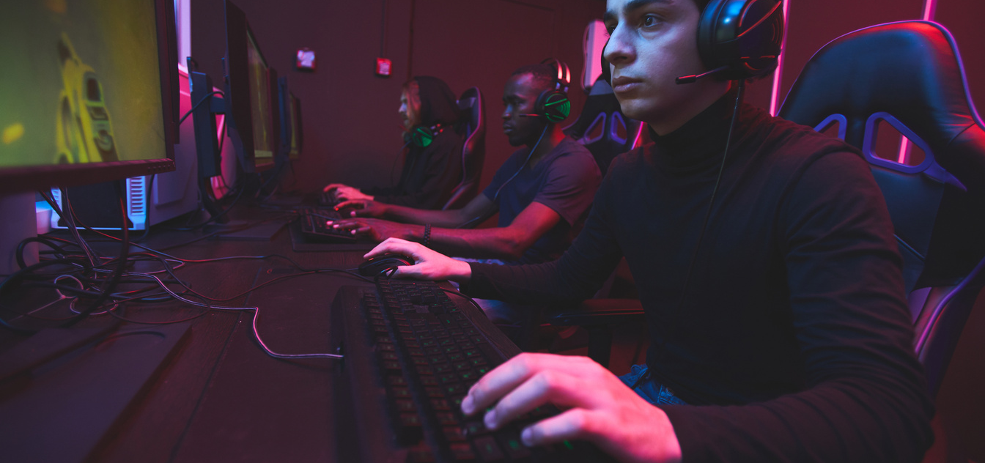

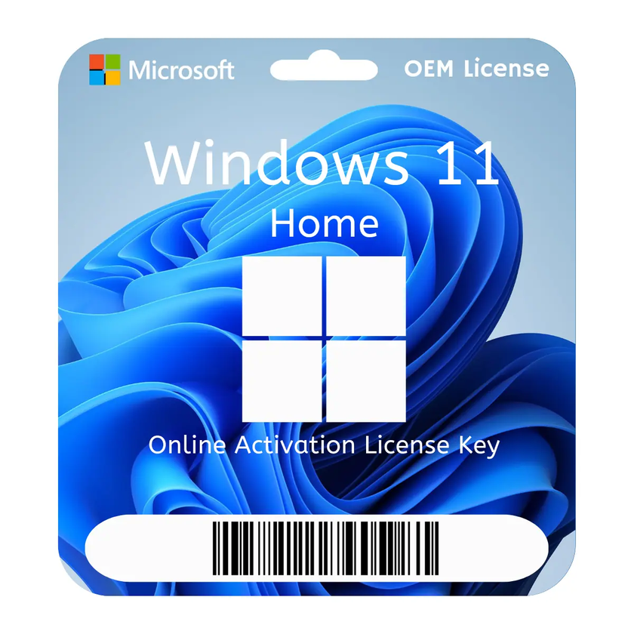
OPERATING SYSTEM
WINDOWS 11
Home
RM 90

Slide 26
Hardware | Product Name | Price (RM)
GPU | AMD RYZEN 7 5700X 4.6GHZ | 748
CPU | ZOTAC RTX 4060 8GB TWIN EDGE | 1559
Motherboard | MSI B450M BAZOOKA MAX WIFI | 329
RAM | CORSAIR VENGEANCE RGB PRO 16GB (2 x 8GB) DDR4 DRAM 3200MHz | 275
HDD | SEAGATE SKYHAWK HDD 1TB | 130
SSD | XPG SX8200 PRO 500GB | 239
Power Supply | CORSAIR RM750 | 440
Chassis | NZXT H510 ATX MID TOWER CASING | 347
Cooler Liquid | MASTERLIQUID 240L CORE ARGB | 229
Cooler Fan | COOLER MASTER MASTERFAN MF120 HALO2 | 138
OS | Windows 11 | 90
 | Total | 4524
PRICE LIST OF 2st PC

Slide 27
Performance Chart for Game Development and Gaming at 4K
Component | Task/Workload | Impact on Performance | Estimated Performance
CPU: AMD Ryzen 7 5700X | Compiling Code | High Impact (Multi-core efficiency) | Fast compile times, handles large codebases smoothly.
 | Running Simulations | High Impact (Multi-threading) | Efficient processing of complex simulations, stable FPS.
 | 3D Rendering | High Impact (Clock speed + Cores) | Quick rendering times for 3D assets, maintains high FPS.
 | Game Logic & AI Processing | Medium to High Impact | Smooth gameplay, stable FPS in AI-heavy scenarios.
 | Multi-tasking with 4K assets | High Impact | Efficient handling of multiple apps, no slowdowns.
GPU: Zotac RTX 4060 | 4K Texture Rendering | High Impact | 60-75 FPS (Medium settings in most games)
 | Real-time Ray Tracing (RT ON) | High Impact | 35-50 FPS (Medium settings in demanding titles)
 | Game Testing at 4K | High Impact | 55-75 FPS (Optimized games, Medium-High settings)
RAM: 16GB DDR4 | Managing Large Datasets | High Impact | Smooth performance with large 4K assets and textures.
 | Multitasking | High Impact | No memory bottlenecks, stable performance.
Storage: 500GB SSD + 1TB HDD | Loading Large Projects/Assets | High Impact (SSD Speed) | Fast load times, minimal delays when accessing assets.
Overall System | 4K Game Development Workflow | High Efficiency | Smooth and responsive, handles complex tasks effectively.

Slide 28
Expected FPS Performance:
Game Title | Resolution | Settings | Estimated FPS
Unreal Engine Demo | 1080p | High | 100-120 FPS
Unity Engine | 1080p | High | 110-130 FPS
Cyberpunk 2077 | 1080p | High (RT Off) | 90-110 FPS
Fortnite | 1440p | High | 120-140 FPS
Call of Duty: Warzone | 1440p | High | 100-120 FPS
Estimated FPS Performance at 4K Resolution:
Game Title | Settings | Estimated FPS
Unreal Engine Demo | Medium | 60-75 FPS
Unity Engine | Medium | 65-80 FPS
Cyberpunk 2077 | Medium (RT Off) | 35-50 FPS
Fortnite | High | 55-70 FPS
Call of Duty: Warzone | Medium | 60-75 FPS

Slide 29




Slide 30
CPU
INTEL
I5-12600KF
Vs
AMD RYZEN
7 5700X 4.6GHZ
RM 1050
RM 748

Slide 31
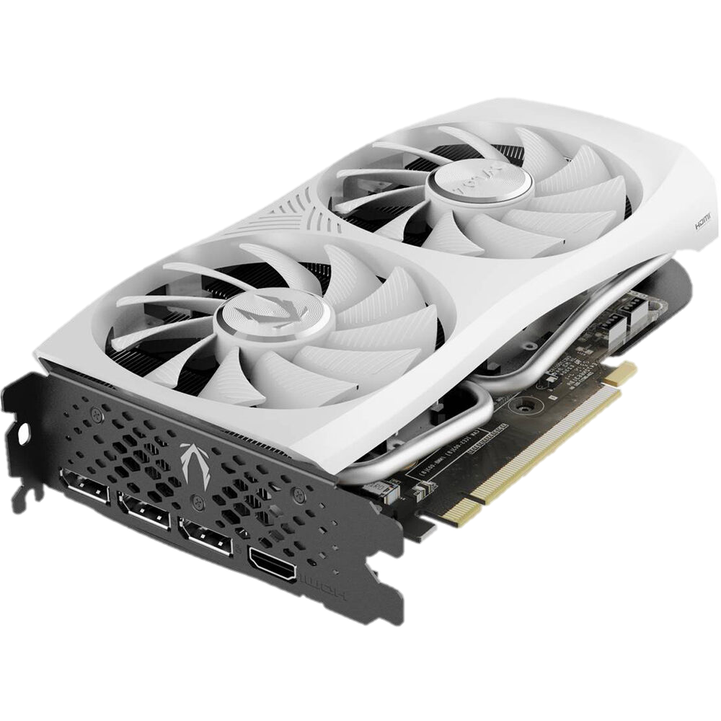
GPU
GIGABYTE
ZOTAC
RTX 3060
WINDFORCE
OC 12GB
GDDR6
RTX 4060 8GB TWIN EDGE
RM1429
RM 1,559

Slide 32
THANK
YOU

